Slide 1

CANDIDATE ASSESSMENT
BUSINESS INTELLIGENCE TEAM
DATA SCIENTIST ASSESSMENT
Candidate: Panagiotis Sakkis
Email: pansakkis95@gmail.com

Slide 2
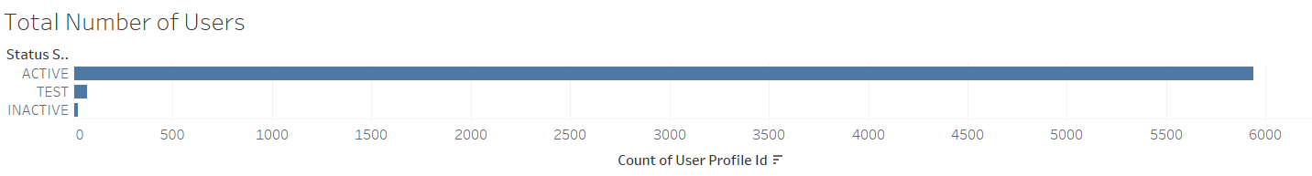
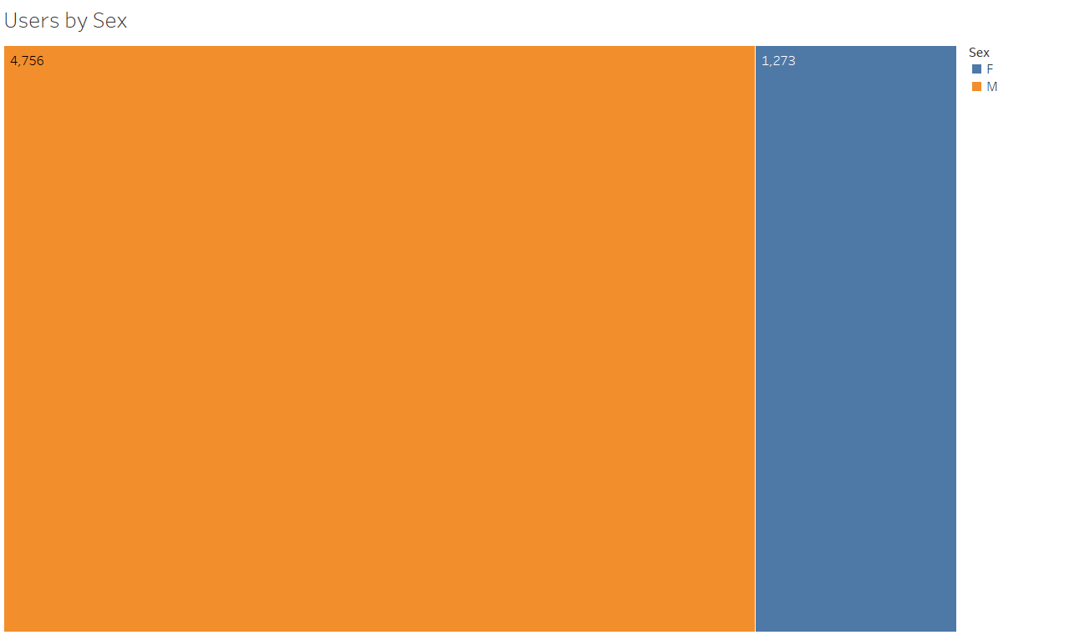
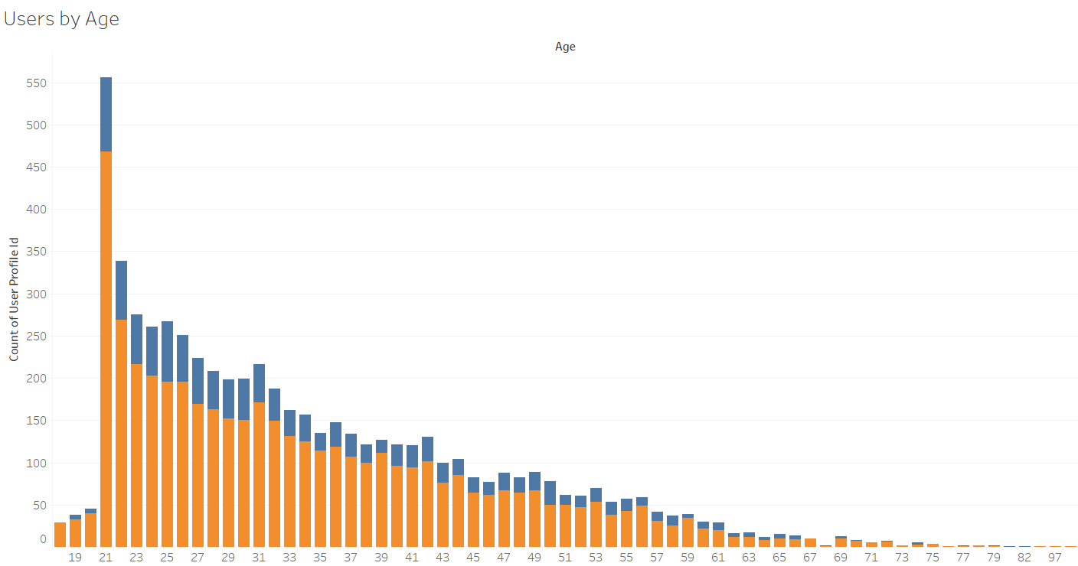
Users Overview
The first part of this presentation is focused in analyzing users personal data and getting insights of their profile.
Total Number of Users = 6,029 - 78.8% of our users are Male and 28% of our users are in the age group 21-25

Slide 3
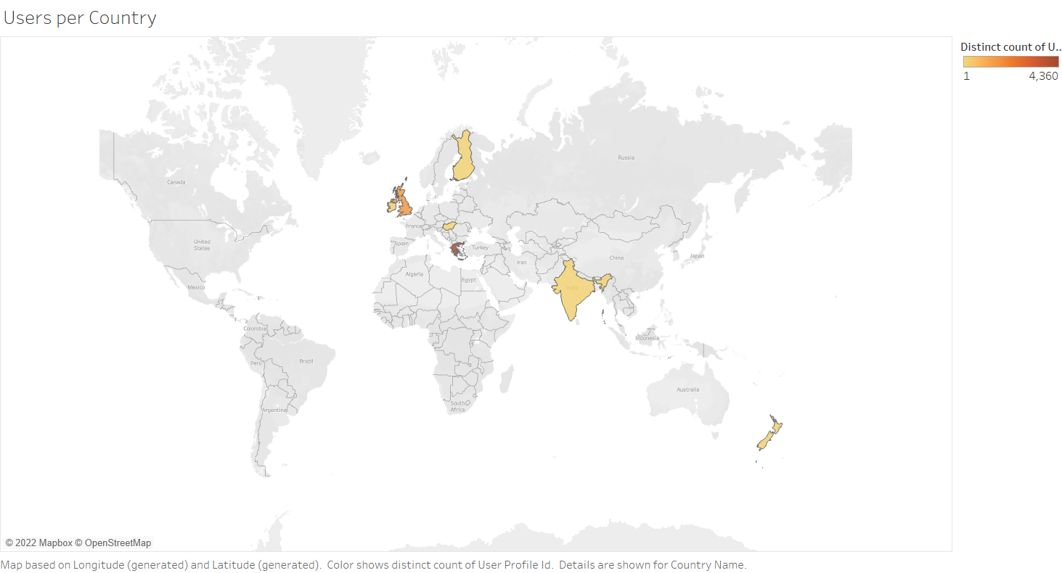
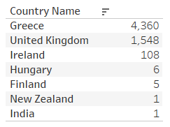
Users Geographical Spread
The 2 largest markets are Greece and UK with 72.3% and 25.6% of users respectively. So it is interesting to look in more depth in these countries.

Slide 4
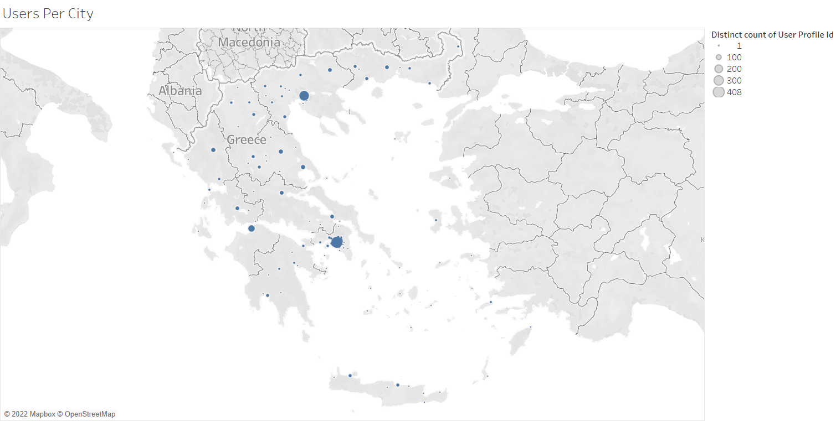
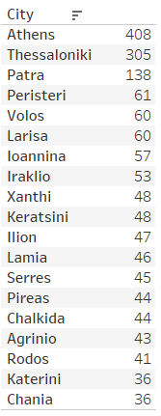
Users - Greek Market
Top 20 Greek Cities

Slide 5
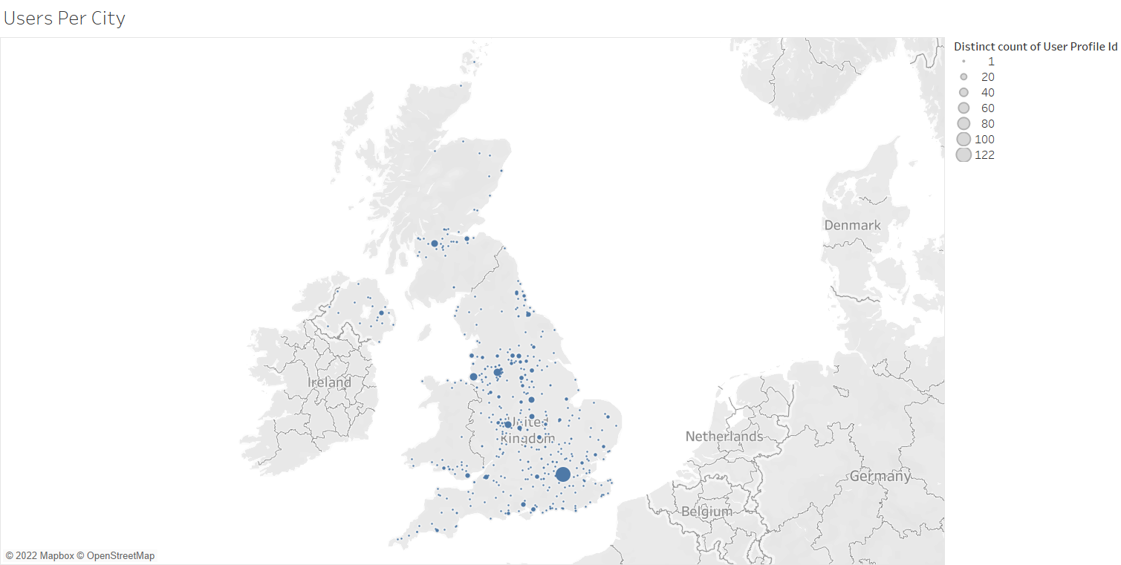
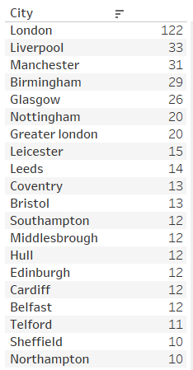
Users - UK Market
Top 20 UK Cities

Slide 6
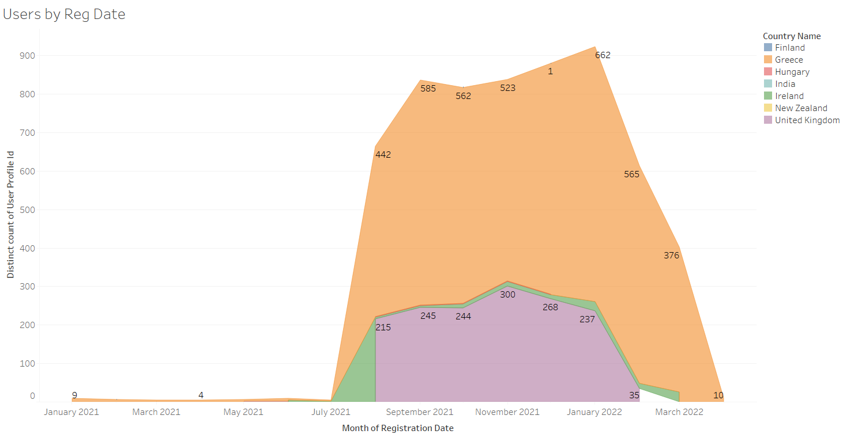
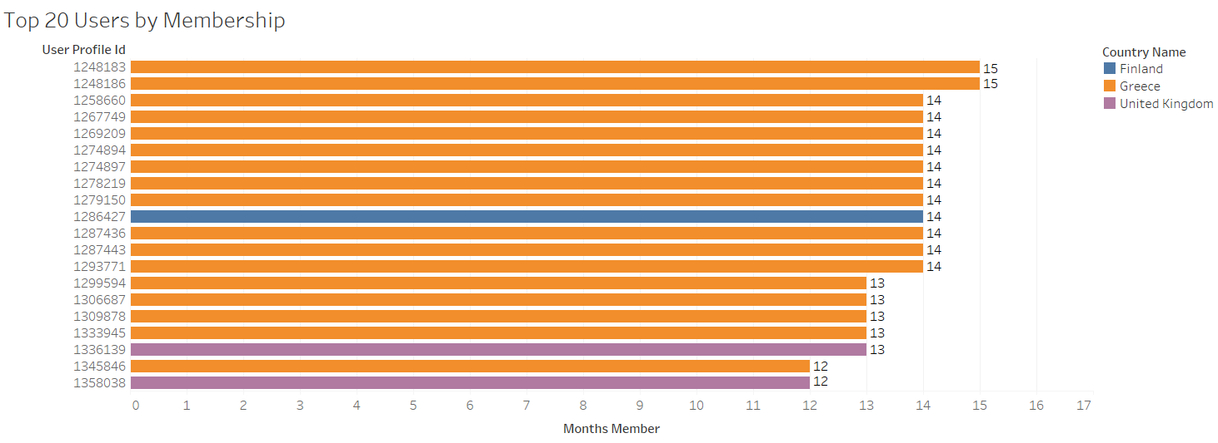
Users by Registration
We can see that the 2nd semester of 2021 the number of registered users has increased dramatically.
Our 20 longest members and their country of origin.

Slide 7
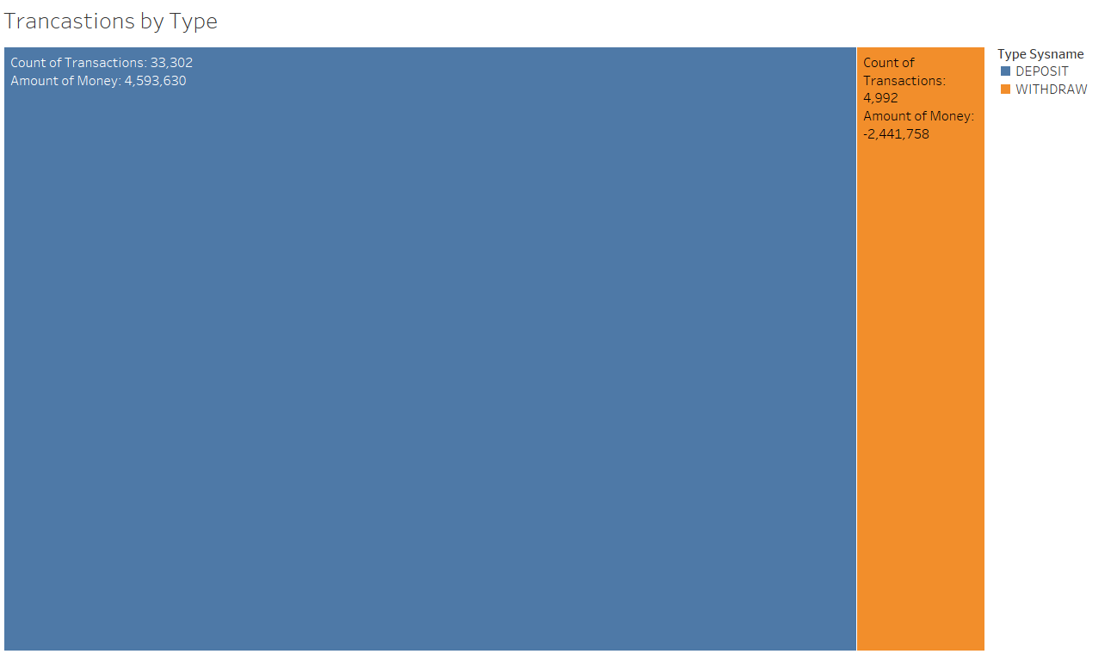
Wallet Transaction Overview
The second part of this presentation analyses the transactions in the user wallets.
There have been a total of 38,294 transactions in the system with 87% of them being deposits of 4,5M euros total.

Slide 8
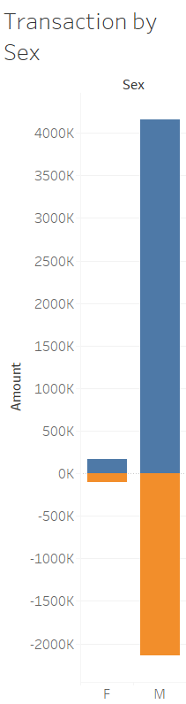
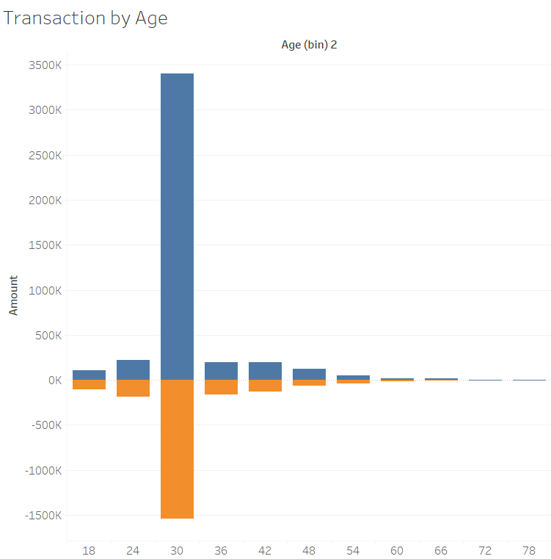
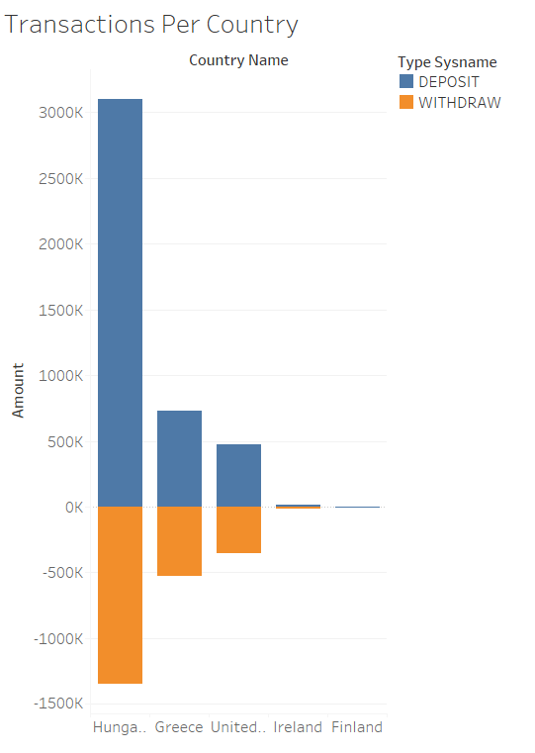
Transactions by User Characteristics
Clearly, men spend more than women and the age group of 24-30. Also, the huge amounts from Hungary require further analysis since there are only 6 users there.

Slide 9
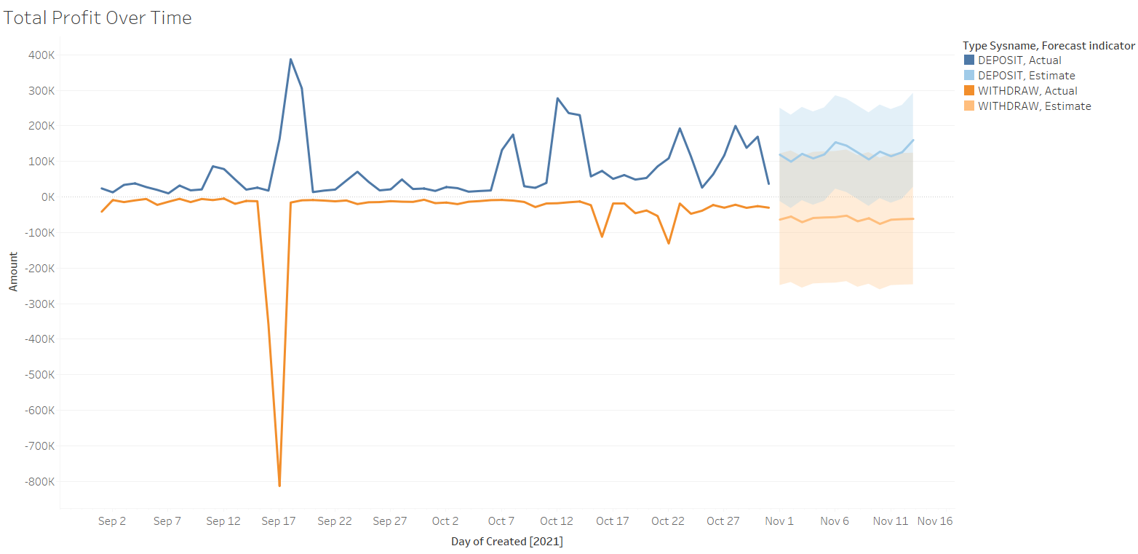
Transactions over Time
The huge withdraw in September 17 seems suspicious and requires in-depth analysis.

Slide 10
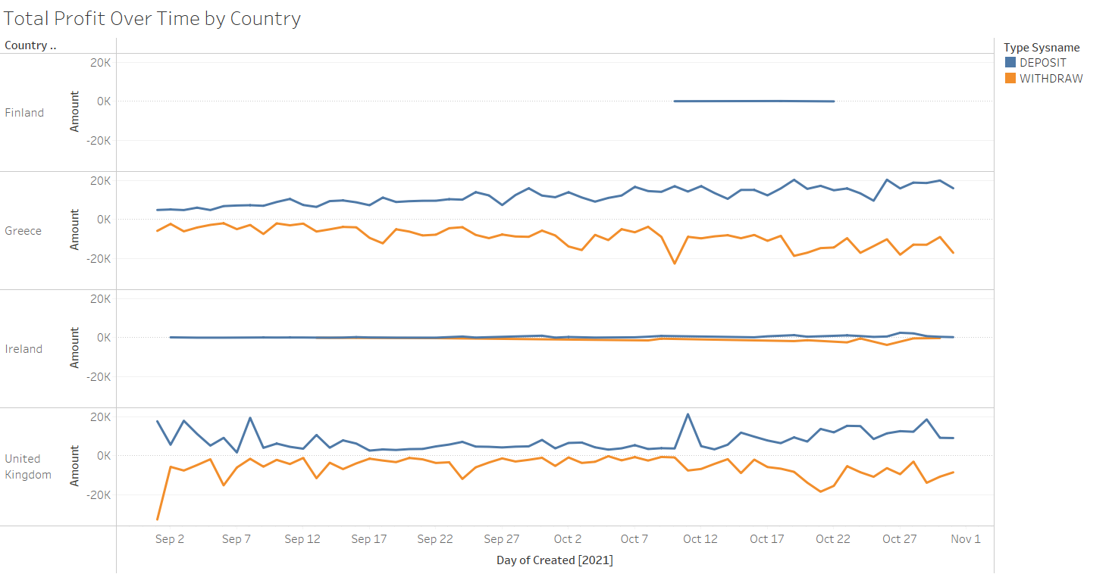
Transactions over Time

Slide 11
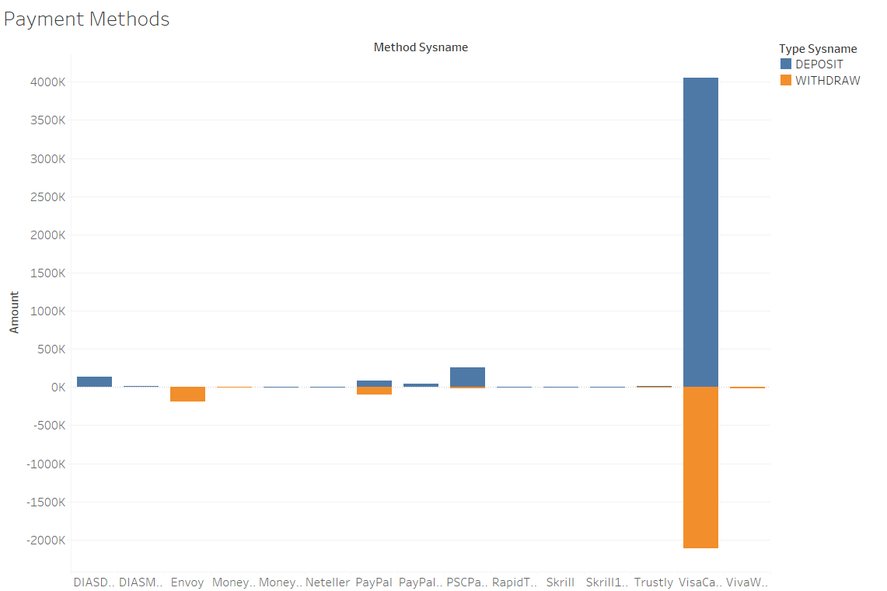
Transactions – Payment Methods

Slide 12
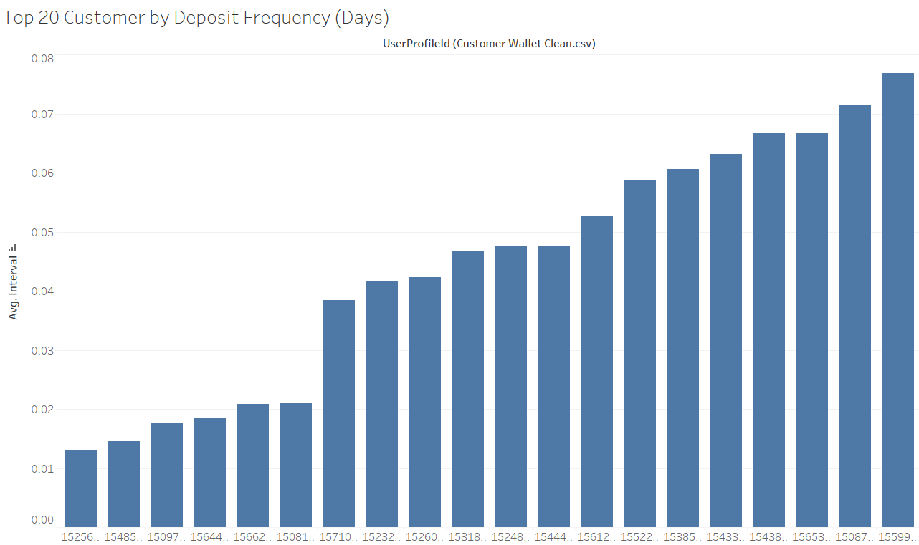
Transactions – Top Users by Deposit Freq

Slide 13
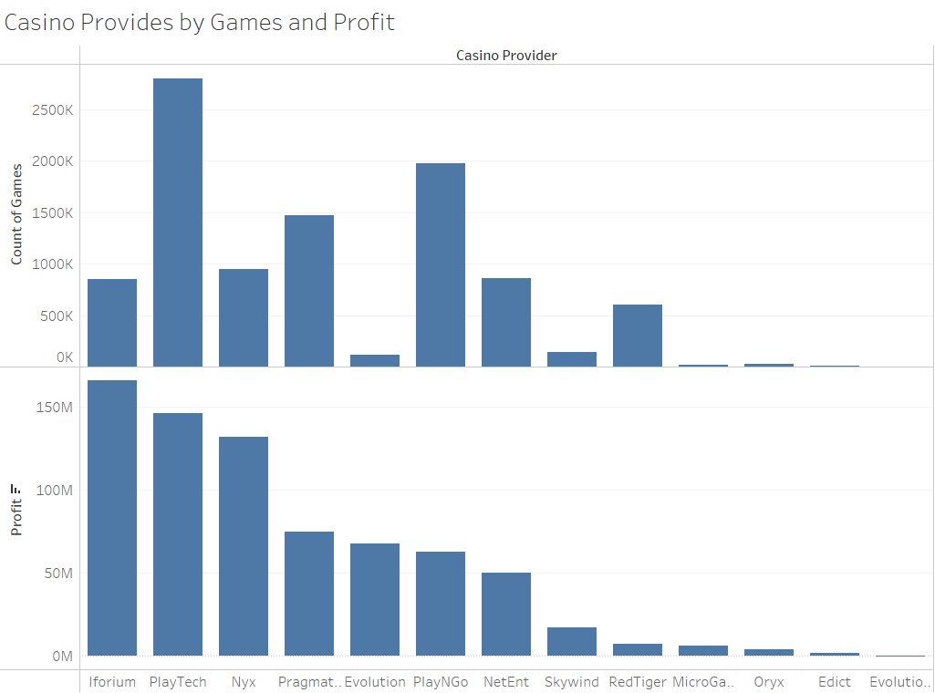
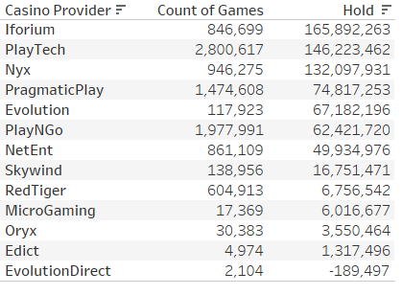
Casino Games Overview
The third and last part of this presentation shows the casino games profit and use.
There have been a total of 9,823,821 casino events (win/loss) in the system.

Slide 14



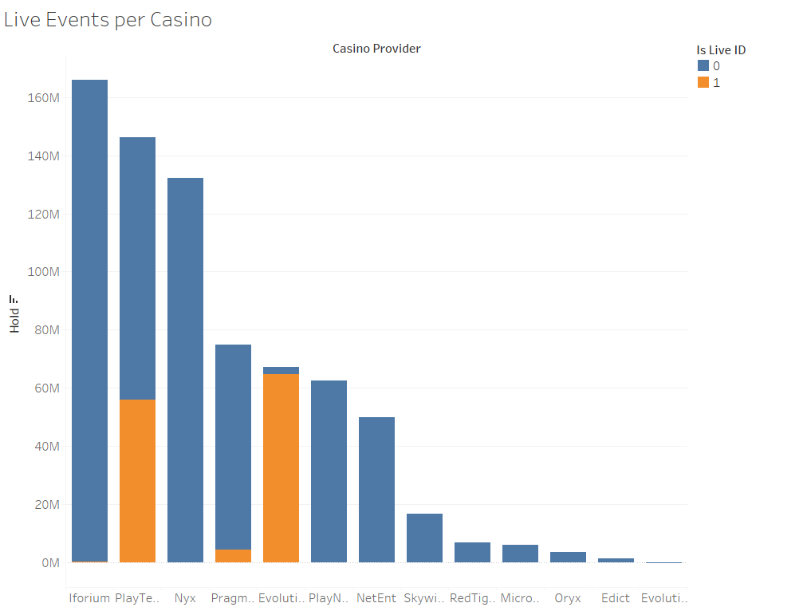
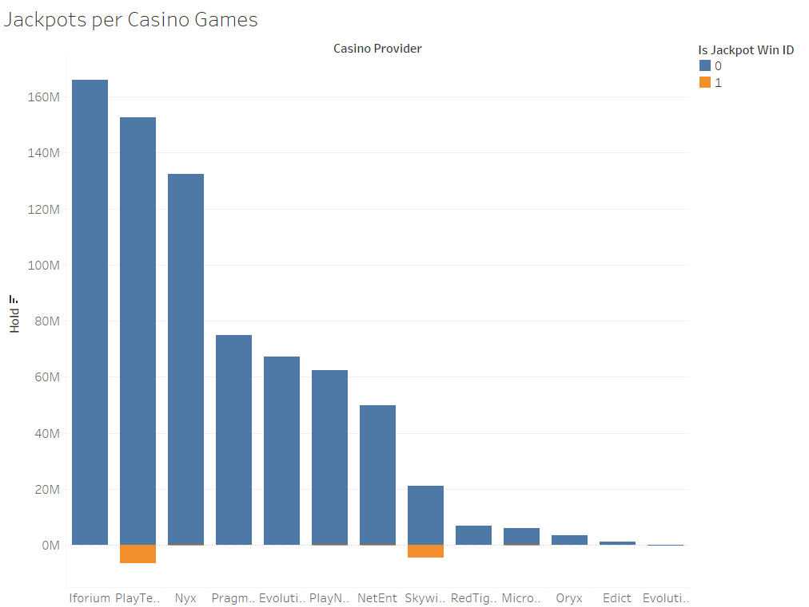
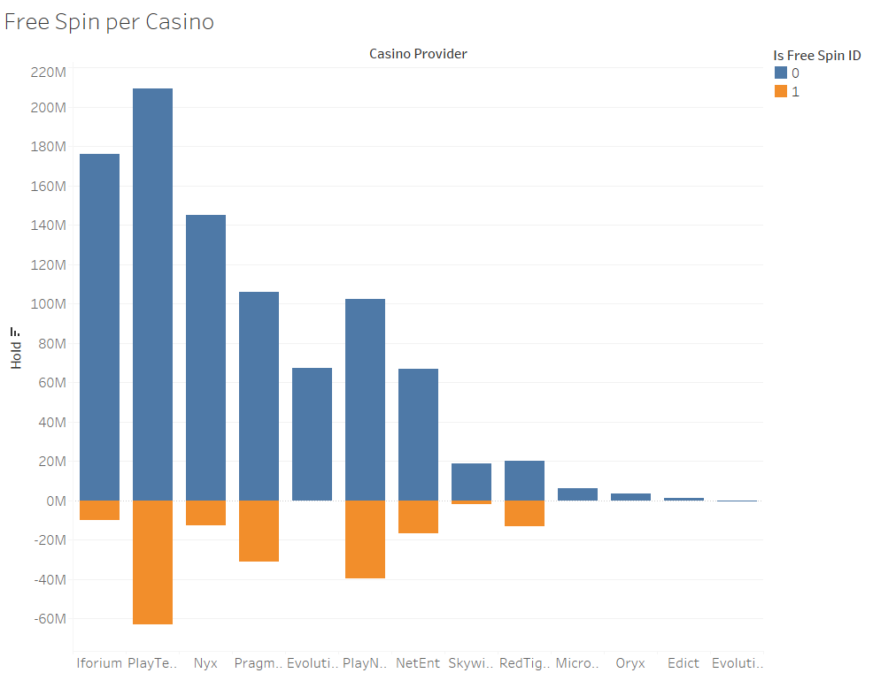
Casino Games Overview
Profit and amount of games by type per Casino Provider

Slide 15
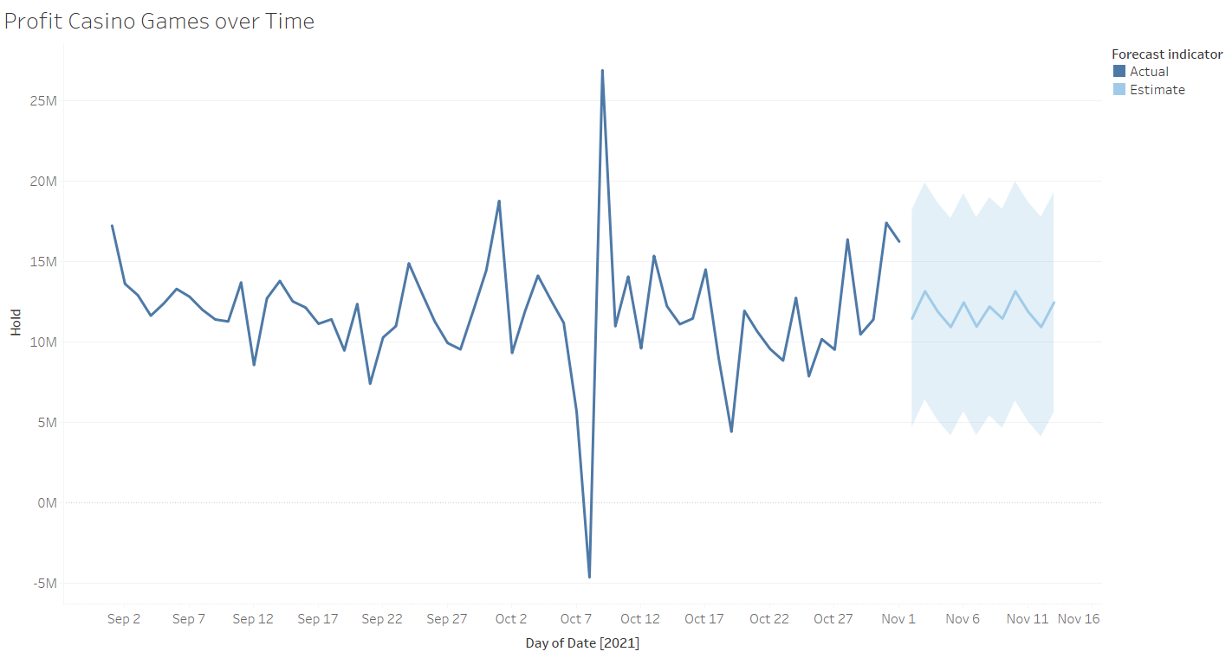
Casino Games Profit over Time

Slide 16
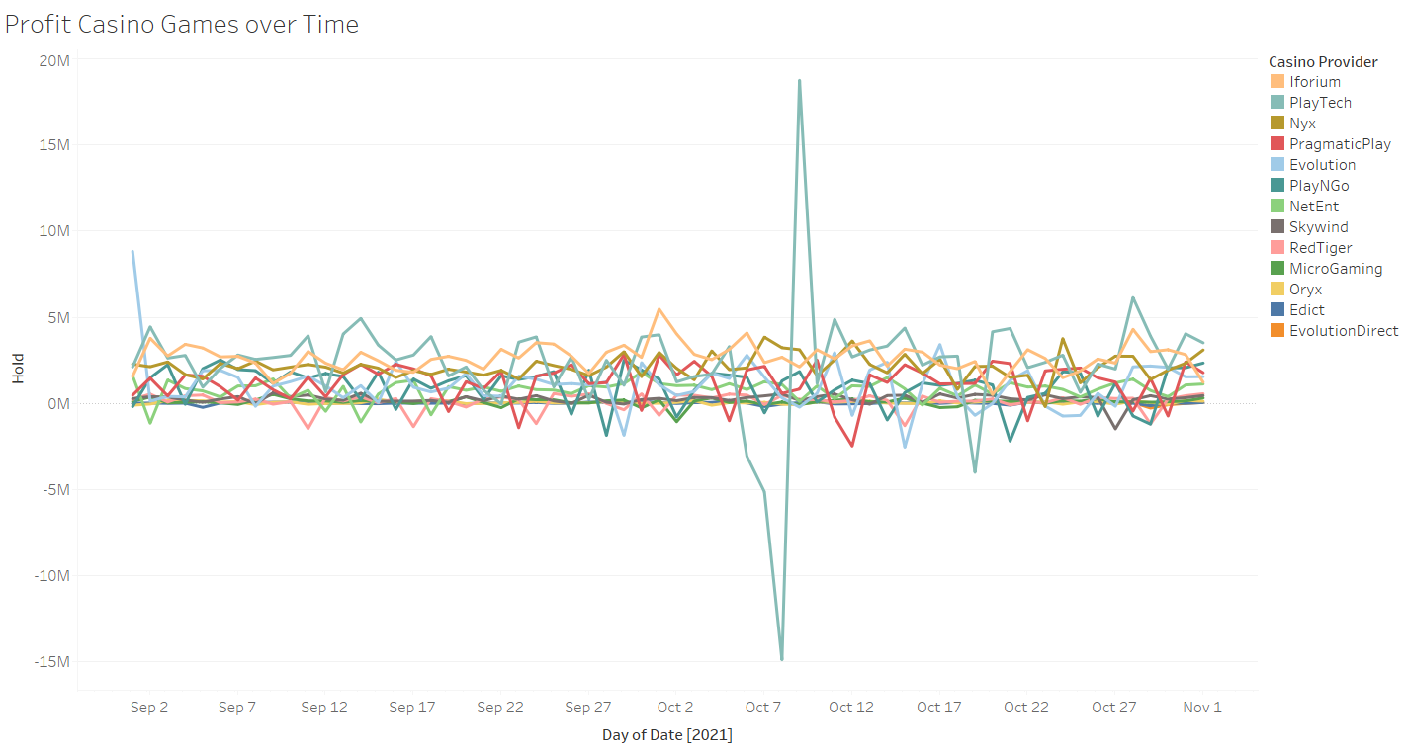
Casino Games Profit over Time

Slide 17
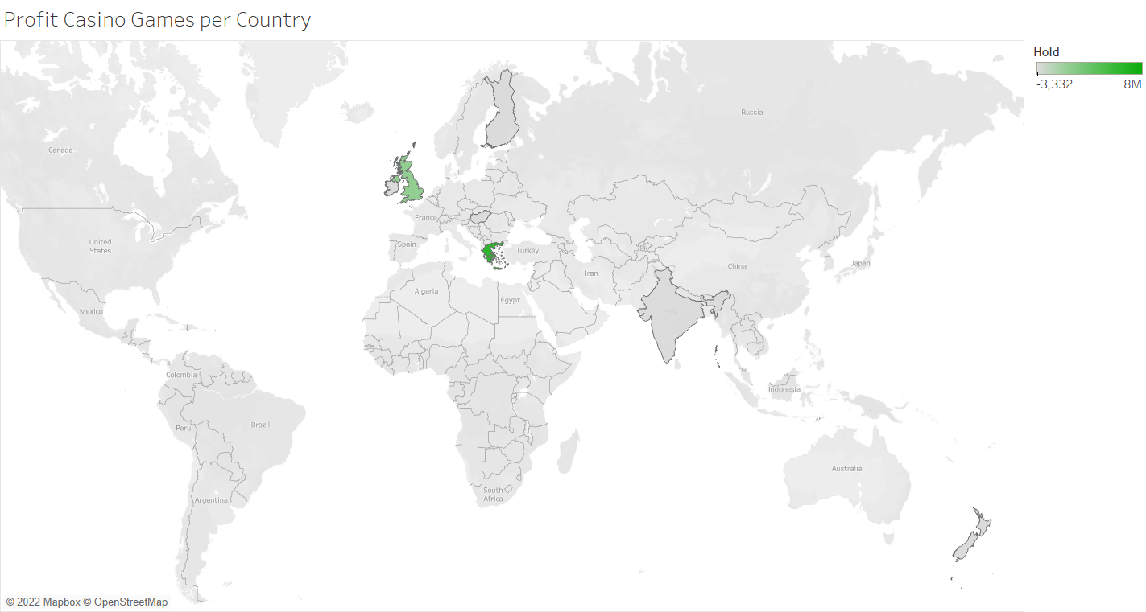
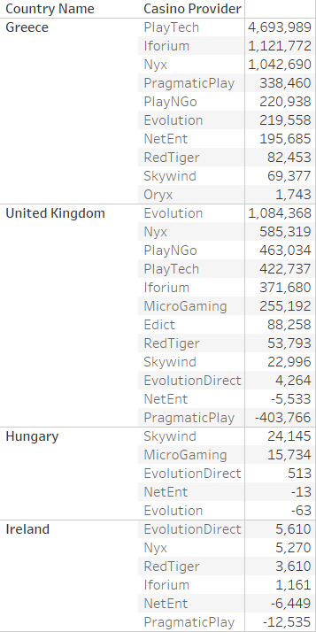
Casino Games Profit per Country

